Slide 1
Factors Affecting Well-being: An analysis using the Panel Study of Income Dynamics
Amel Omari, Babak Khamsehi, Dori Cross, Yichi Zhang
BIOS 512 Final Project
4/16/15
Notes:
Yichi

Slide 2
Overview
Motivation
Descriptive statistics/graphics
Statistical methods
Results and conclusions
Notes:
Yichi

Slide 3
Motivation
Goal
How different characteristics and behaviors influence an individual’s overall wellbeing
Panel Data
Years of data collection: 2005, 2007, 2009, 2011
N=2,149
Total number of observations: 5,290
Avg. data points per person: 1.99
Data points/year:
Data points/Person:
year N
---------+----------
2005 | 742
2007 | 1104
2009 | 1546
2011 | 1898
---------+----------
Total | 5290
--------------------
count | Freq. Percent Cum.
------------+-----------------------------------
1 | 2,149 40.62 40.62
2 | 1,570 29.68 70.30
3 | 1,023 19.34 89.64
4 | 548 10.36 100.00
------------+-----------------------------------
Total | 5,290 100.00
Notes:
Yichi
There are missing data points – some people are missing data points at some time points, and additionally missing data for specific variables.

Slide 4
Dataset
Variable Description | Type of variable
Level 1 Variables: Time-Varying
Respondent’s age at time of interview | Continuous
Indicator for whether or not respondent volunteered during the current year, collected each year | Binary
Frequency of volunteer activity, collected each year | Categorical, 0-6
Self reported health, collected each year | Categorical, 1-5
How often respondent engages in vigorous activity, collected each year | Categorical, 1-6
How often respondent engages in light activity, collected each year | Categorical, 1-6
Indicator of whether respondent currently smokes, collected each year | Binary
Indicator of whether respondent currently drinks alcohol, collected each year | Binary
Indicator on whether respondent considers themselves spiritual, collected yearly | Binary
Internet use score calculated using several internet use measures, collected each year | Continuous
Level 2 Variables: Time Invariant
Unique ID
Sex of the individual | 1=Male 2=Female
Respondent’s race | 1=White 2=Black 3=Other
Respondent’s baseline BMI | Continuous
Dependent Variable
Respondent’s overall well-being score | Continuous
Notes:
Yichi
Some of these variables were manipulated during data management, such as exercise, which was skewed and had a lot of missing data.
Used BMICat rather than continuous, though we checked both.
Used only whether someone had volunteered, not dose, since this data was very skewed.

Slide 5
Descriptive Statistics
Insert table of means of key variables
variable | N mean sd min max
-------------+--------------------------------------------------
id | 5290 1066.429 619.3611 1 2155
year | 5290 2008.739 2.108783 2005 2011
sex | 5290 1.524197 .4994614 1 2
age | 5290 20.83592 2.444142 17 27
vol | 5288 .288767 .4532323 0 1
volfreq | 5289 .6606164 1.218693 0 6
health | 5281 2.193145 .9096486 1 5
vigact | 3603 2.426311 1.672954 1 6
lightact | 3606 2.127011 1.515507 1 6
smoke | 5282 .2260507 .418312 0 1
alcohol | 5276 .6347612 .4815427 0 1
spirit | 5274 .593667 .4911947 0 1
wb | 5290 13.68885 2.515817 3 18
intuse | 5289 10.70902 3.996055 0 24
race | 5282 1.56418 .6167428 1 3
bmi | 5281 24.80949 5.179625 15.3 53.9
----------------------------------------------------------------
Notes:
Yichi

Slide 6
Graphics (1): Overall Well-being, by year and sex
Notes:
Babak
There isn’t a lot of variability by sex

Slide 7
Graphics(2): Box Plots over Level 2 Variables
Notes:
Babak
Also not a lot of variability in well being by race or BMI category
Did not observe very much variability in several other descriptive charts.

Slide 8
Fitting the Model
Aims:
How much does well-being vary within person over time? (i.e. How important is time as a predictor of well-being?)
Which variables are significant predictors of variation in well-being?
What is the effect of adding level 2 predictors?
Should this be a linear mixed or marginal model?
Notes:
Amel

Slide 9
The effect of time on well-being
Age in subsample
Coefficient = 0.0004306
P=0.995
Year in subsample
Coefficient = -0.05534
P=0.404
Notes:
Amel
Ran a linear mixed model with a single fixed effect for year or age, results shown here
Year was significant in the full sample (p=0.001), but the coefficient was still small (0.04122)
Age significance
Controlling for year but not considering it as a major impact on well-being
When both year and age are included in the full model, they are both insignificant.

Slide 10
Top-down Model Fitting Approach
Notes:
Amel

Slide 11
wb | Coef. Std. Err. z P>|z| [95% Conf. Interval]
-------------------------+----------------------------------------------------------------
vol | .2417476 .0798385 3.03 0.002 .085267 .3982282
|
health |
Excellent | 2.274034 .4290645 5.30 0.000 1.433083 3.114985
Very Good | 1.915622 .4251971 4.51 0.000 1.082251 2.748993
Good | 1.382367 .4266634 3.24 0.001 .5461225 2.218612
Fair | .8186175 .4330127 1.89 0.059 -.0300719 1.667307
|
spirit | .5983863 .0813799 7.35 0.000 .4388845 .757888
smoke | -.5180348 .1075342 -4.82 0.000 -.728798 -.3072716
alcohol | -.070909 .0819648 -0.87 0.387 -.231557 .0897389
intuse | .0742208 .0104606 7.10 0.000 .0537185 .0947232
|
exercise |
light exercise | -.2680714 .2323816 -1.15 0.249 -.723531 .1873883
vigorous exercise | -.1499956 .2972821 -0.50 0.614 -.7326578 .4326666
light&vigorous exercise | -.1526725 .1784377 -0.86 0.392 -.502404 .1970591
|
year | .0348463 .0161423 2.16 0.031 .0032079 .0664847
|
sex |
Female | .1714925 .0985712 1.74 0.082 -.0217036 .3646885
|
race |
black | -.0096109 .1063096 -0.09 0.928 -.2179738 .198752
other | -.4156497 .1897003 -2.19 0.028 -.7874554 -.043844
|
BMICat |
normalweight | .1737495 .1926648 0.90 0.367 -.2038665 .5513655
overweight | .3639268 .1981846 1.84 0.066 -.0245078 .7523614
|
_cons | -59.24208 32.41018 -1.83 0.068 -122.7649 4.280714
------------------------------------------------------------------------------------------
Notes:
Amel
Alcohol – not significant and the variable seems unspecific
Decided to keep exercise as a binary variable.

Slide 12
ICC and R² Values
ICC Values
Null Model | 0.53887
Final Model | 0.48224
R² Values
Addition of level 1 compared to null | + 0.78%
Addition of level 2 compared to level 1 | +0.57%
Notes:
Amel
intraclass correlation (ICC) based on the null model (with only random and fixed intercepts). The between-clusters variance is estimated to be 3.44. The within-clusters variance is estimated to be 2.94.
The ICC of the null model is high, indicating that the between-subjects variance is large relative to the within-subjects variance; observations within a subject are similar. The similarity of responses within clusters is high. This indicated a need to include random effects.
By definition, ICC is the ratio of within sample variance and the sum of within sample and between sample variance. In the “adjusted” ICC calculation, more variance is explained by the between sample variance. Therefore, the ICC in the full model is smaller than that in the null model.
R-squared represents additional variance explained with the addition of level 2 variables

Slide 13
LMM vs. Marginal model

Slide 14
Marginal Model vs. LMM
Comparing covariance matrix structures in the marginal model:
Covariance Matrix Structure | AIC | BIC
Unstructured | 23040.89 | 23218.2
Compound Symmetric | 23041.65 | 23166.42
Toeplitz, 1, 2, 3 | -no convergence | -
AR-1 | -no convergence | -
Comparing the marginal model with linear matrix model fit:
Model | AIC | BIC
Marginal Model (unstructured) | 23041.65 | 23166.42
Linear Mixed Model | 23034.14 | 23152.34
Notes:
Babak

Slide 15
Final Model

Slide 16
Final Model
Wb_{t, id} = β₀ + β₁(excellent) + β₂(verygood) + β₃(good) + β₄(fair) + β₅(spirit) + β₆(smoke) + β₇(intuse) + β₈(exercise_binary) + β₉(sex) + β₁₀(black) + β₁₁(other) + β₁₂(normalweight) + β₁₃(overweight) + β₁₄(centbaseage) + β₁₅(centyear) + b_{0id} + ε_{t,id}
b_{0id} ~ N(0, σ²_{intercepts}), ε_{t,id} ~ N(0, σ²_{error})
ε_{t,id} and b_{0id} are independent
Notes:
Dori
Green = self-rated health dummy variables
Black = continuous and binary variables
Blue = racial identity dummy variables
Orange = BMI category dummy variables
Red = time-related variables (even though baseline age does not vary over time)

Slide 17
Final Model: Regression Output
-----------------------------------------------------------------------------------
wb | Coef. Std. Err. z P>|z| [95% Conf. Interval]
------------------+----------------------------------------------------------------
vol | .2690381 .0687574 3.91 0.000 .1342762 .4038001
|
health |
Excellent | 2.087576 .3499693 5.97 0.000 1.401649 2.773503
Very Good | 1.758287 .3465477 5.07 0.000 1.079066 2.437508
Good | 1.336157 .3467464 3.85 0.000 .6565471 2.015768
Fair | .8861372 .3519783 2.52 0.012 .1962725 1.576002
|
spirit | .5666083 .0676984 8.37 0.000 .4339219 .6992947
smoke | -.5450757 .0860225 -6.34 0.000 -.7136767 -.3764747
intuse | .0674678 .0082594 8.17 0.000 .0512797 .083656
1.exercise_binary | -.1495332 .1721561 -0.87 0.385 -.4869531 .1878866
|
sex |
Female | .2375147 .0887758 2.68 0.007 .0635174 .411512
race |
black | -.0057229 .0942832 -0.06 0.952 -.1905145 .1790688
other | -.3608464 .1765968 -2.04 0.041 -.7069698 -.0147229
|
BMICat |
normalweight | .1403612 .1740851 0.81 0.420 -.2008392 .4815617
overweight | .2796972 .1791765 1.56 0.119 -.0714822 .6308767
|
centbaseage | .0012582 .035174 0.04 0.971 -.0676815 .0701979
centyear | .0358163 .0125052 2.86 0.004 .0113066 .060326
_cons | 10.75806 .4262369 25.24 0.000 9.922653 11.59347
-----------------------------------------------------------------------------------
Notes:
Dori
In general all the variables are significant except for exercise_binary, black, BMI category, and centbaseage.
In general all the variables have a direct relationship with wellbeing, with the exception of smoking, exercise, and non-white race which have an inverse relationship with wellbeing.
The largest effect sizes are self-rated health, spirituality, and smoking.
Intercept is 10.76, meaning a person who does not volunteer, has poor health, is not spiritual, does not smoke, does not use the internet, does not exercise, is male, is white, is underweight, is 17, and had their interview in 2005.
------------------------------------------------------------------------------
Random-effects Parameters | Estimate Std. Err. [95% Conf. Interval]
-----------------------------+------------------------------------------------
id: Identity |
var(_cons) | 2.712048 .1312675 2.466595 2.981926
-----------------------------+------------------------------------------------
var(Residual) | 2.911722 .073967 2.770299 3.060364

Slide 18
Final Model: Interpretation(1)
-----------------------------------------------------------------------------------
wb | Coef. Std. Err. z P>|z| [95% Conf. Interval]
------------------+----------------------------------------------------------------
vol | .2690381 .0687574 3.91 0.000 .1342762 .4038001
|
health |
Excellent | 2.087576 .3499693 5.97 0.000 1.401649 2.773503
Very Good | 1.758287 .3465477 5.07 0.000 1.079066 2.437508
Good | 1.336157 .3467464 3.85 0.000 .6565471 2.015768
Fair | .8861372 .3519783 2.52 0.012 .1962725 1.576002
|
spirit | .5666083 .0676984 8.37 0.000 .4339219 .6992947
smoke | -.5450757 .0860225 -6.34 0.000 -.7136767 -.3764747
intuse | .0674678 .0082594 8.17 0.000 .0512797 .083656
1.exercise_binary | -.1495332 .1721561 -0.87 0.385 -.4869531 .1878866
|
sex |
Female | .2375147 .0887758 2.68 0.007 .0635174 .411512
race |
black | -.0057229 .0942832 -0.06 0.952 -.1905145 .1790688
other | -.3608464 .1765968 -2.04 0.041 -.7069698 -.0147229
|
BMICat |
normalweight | .1403612 .1740851 0.81 0.420 -.2008392 .4815617
overweight | .2796972 .1791765 1.56 0.119 -.0714822 .6308767
|
centbaseage | .0012582 .035174 0.04 0.971 -.0676815 .0701979
centyear | .0358163 .0125052 2.86 0.004 .0113066 .060326
_cons | 10.75806 .4262369 25.24 0.000 9.922653 11.59347
-----------------------------------------------------------------------------------
Notes:
Dori
In general all the variables are significant except for exercise_binary, black, BMI category, and centbaseage.
In general all the variables have a direct relationship with wellbeing, with the exception of smoking, exercise, and non-white race which have an inverse relationship with wellbeing.
The largest effect sizes are self-rated health, spirituality, and smoking.
Intercept is 10.76, meaning a person who does not volunteer, has poor health, is not spiritual, does not smoke, does not use the internet, does not exercise, is male, is white, is underweight, is 17, and had their interview in 2005.
------------------------------------------------------------------------------
Random-effects Parameters | Estimate Std. Err. [95% Conf. Interval]
-----------------------------+------------------------------------------------
id: Identity |
var(_cons) | 2.712048 .1312675 2.466595 2.981926
-----------------------------+------------------------------------------------
var(Residual) | 2.911722 .073967 2.770299 3.060364

Slide 19
Final Model: Interpretation (2)
-----------------------------------------------------------------------------------
wb | Coef. Std. Err. z P>|z| [95% Conf. Interval]
------------------+----------------------------------------------------------------
vol | .2690381 .0687574 3.91 0.000 .1342762 .4038001
|
health |
Excellent | 2.087576 .3499693 5.97 0.000 1.401649 2.773503
Very Good | 1.758287 .3465477 5.07 0.000 1.079066 2.437508
Good | 1.336157 .3467464 3.85 0.000 .6565471 2.015768
Fair | .8861372 .3519783 2.52 0.012 .1962725 1.576002
|
spirit | .5666083 .0676984 8.37 0.000 .4339219 .6992947
smoke | -.5450757 .0860225 -6.34 0.000 -.7136767 -.3764747
intuse | .0674678 .0082594 8.17 0.000 .0512797 .083656
1.exercise_binary | -.1495332 .1721561 -0.87 0.385 -.4869531 .1878866
|
sex |
Female | .2375147 .0887758 2.68 0.007 .0635174 .411512
race |
black | -.0057229 .0942832 -0.06 0.952 -.1905145 .1790688
other | -.3608464 .1765968 -2.04 0.041 -.7069698 -.0147229
|
BMICat |
normalweight | .1403612 .1740851 0.81 0.420 -.2008392 .4815617
overweight | .2796972 .1791765 1.56 0.119 -.0714822 .6308767
|
centbaseage | .0012582 .035174 0.04 0.971 -.0676815 .0701979
centyear | .0358163 .0125052 2.86 0.004 .0113066 .060326
_cons | 10.75806 .4262369 25.24 0.000 9.922653 11.59347
-----------------------------------------------------------------------------------
Notes:
Dori
In general all the variables are significant except for exercise_binary, black, BMI category, and centbaseage.
In general all the variables have a direct relationship with wellbeing, with the exception of smoking, exercise, and non-white race which have an inverse relationship with wellbeing.
The largest effect sizes are self-rated health, spirituality, and smoking.
Intercept is 10.76, meaning a person who does not volunteer, has poor health, is not spiritual, does not smoke, does not use the internet, does not exercise, is male, is white, is underweight, is 17, and had their interview in 2005.
------------------------------------------------------------------------------
Random-effects Parameters | Estimate Std. Err. [95% Conf. Interval]
-----------------------------+------------------------------------------------
id: Identity |
var(_cons) | 2.712048 .1312675 2.466595 2.981926
-----------------------------+------------------------------------------------
var(Residual) | 2.911722 .073967 2.770299 3.060364

Slide 20
Final Model: Interpretation (3)
-----------------------------------------------------------------------------------
wb | Coef. Std. Err. z P>|z| [95% Conf. Interval]
------------------+----------------------------------------------------------------
vol | .2690381 .0687574 3.91 0.000 .1342762 .4038001
|
health |
Excellent | 2.087576 .3499693 5.97 0.000 1.401649 2.773503
Very Good | 1.758287 .3465477 5.07 0.000 1.079066 2.437508
Good | 1.336157 .3467464 3.85 0.000 .6565471 2.015768
Fair | .8861372 .3519783 2.52 0.012 .1962725 1.576002
|
spirit | .5666083 .0676984 8.37 0.000 .4339219 .6992947
smoke | -.5450757 .0860225 -6.34 0.000 -.7136767 -.3764747
intuse | .0674678 .0082594 8.17 0.000 .0512797 .083656
1.exercise_binary | -.1495332 .1721561 -0.87 0.385 -.4869531 .1878866
|
sex |
Female | .2375147 .0887758 2.68 0.007 .0635174 .411512
race |
black | -.0057229 .0942832 -0.06 0.952 -.1905145 .1790688
other | -.3608464 .1765968 -2.04 0.041 -.7069698 -.0147229
|
BMICat |
normalweight | .1403612 .1740851 0.81 0.420 -.2008392 .4815617
overweight | .2796972 .1791765 1.56 0.119 -.0714822 .6308767
|
centbaseage | .0012582 .035174 0.04 0.971 -.0676815 .0701979
centyear | .0358163 .0125052 2.86 0.004 .0113066 .060326
_cons | 10.75806 .4262369 25.24 0.000 9.922653 11.59347
-----------------------------------------------------------------------------------
Notes:
Dori
In general all the variables are significant except for exercise_binary, black, BMI category, and centbaseage.
In general all the variables have a direct relationship with wellbeing, with the exception of smoking, exercise, and non-white race which have an inverse relationship with wellbeing.
The largest effect sizes are self-rated health, spirituality, and smoking.
Intercept is 10.76, meaning a person who does not volunteer, has poor health, is not spiritual, does not smoke, does not use the internet, does not exercise, is male, is white, is underweight, is 17, and had their interview in 2005.
------------------------------------------------------------------------------
Random-effects Parameters | Estimate Std. Err. [95% Conf. Interval]
-----------------------------+------------------------------------------------
id: Identity |
var(_cons) | 2.712048 .1312675 2.466595 2.981926
-----------------------------+------------------------------------------------
var(Residual) | 2.911722 .073967 2.770299 3.060364

Slide 21
Final Model: Interpretation (4)
-----------------------------------------------------------------------------------
wb | Coef. Std. Err. z P>|z| [95% Conf. Interval]
------------------+----------------------------------------------------------------
vol | .2690381 .0687574 3.91 0.000 .1342762 .4038001
|
health |
Excellent | 2.087576 .3499693 5.97 0.000 1.401649 2.773503
Very Good | 1.758287 .3465477 5.07 0.000 1.079066 2.437508
Good | 1.336157 .3467464 3.85 0.000 .6565471 2.015768
Fair | .8861372 .3519783 2.52 0.012 .1962725 1.576002
|
spirit | .5666083 .0676984 8.37 0.000 .4339219 .6992947
smoke | -.5450757 .0860225 -6.34 0.000 -.7136767 -.3764747
intuse | .0674678 .0082594 8.17 0.000 .0512797 .083656
1.exercise_binary | -.1495332 .1721561 -0.87 0.385 -.4869531 .1878866
|
sex |
Female | .2375147 .0887758 2.68 0.007 .0635174 .411512
race |
black | -.0057229 .0942832 -0.06 0.952 -.1905145 .1790688
other | -.3608464 .1765968 -2.04 0.041 -.7069698 -.0147229
|
BMICat |
normalweight | .1403612 .1740851 0.81 0.420 -.2008392 .4815617
overweight | .2796972 .1791765 1.56 0.119 -.0714822 .6308767
|
centbaseage | .0012582 .035174 0.04 0.971 -.0676815 .0701979
centyear | .0358163 .0125052 2.86 0.004 .0113066 .060326
_cons | 10.75806 .4262369 25.24 0.000 9.922653 11.59347
-----------------------------------------------------------------------------------
Notes:
Dori
In general all the variables are significant except for exercise_binary, black, BMI category, and centbaseage.
In general all the variables have a direct relationship with wellbeing, with the exception of smoking, exercise, and non-white race which have an inverse relationship with wellbeing.
The largest effect sizes are self-rated health, spirituality, and smoking.
Intercept is 10.76, meaning a person who does not volunteer, has poor health, is not spiritual, does not smoke, does not use the internet, does not exercise, is male, is white, is underweight, is 17, and had their interview in 2005.
------------------------------------------------------------------------------
Random-effects Parameters | Estimate Std. Err. [95% Conf. Interval]
-----------------------------+------------------------------------------------
id: Identity |
var(_cons) | 2.712048 .1312675 2.466595 2.981926
-----------------------------+------------------------------------------------
var(Residual) | 2.911722 .073967 2.770299 3.060364

Slide 22
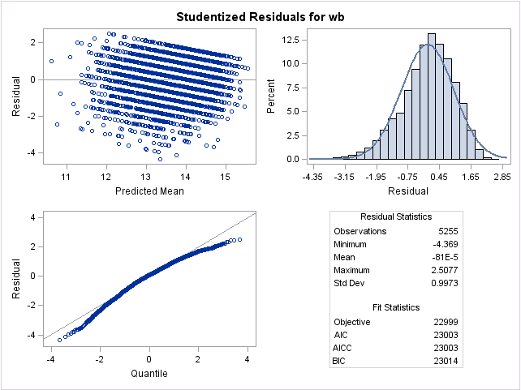
Model diagnostics
Notes:
Dori

Slide 23
APPENDIX

Slide 24
Interaction terms tested
Interaction term | Effect size | P-value
Centage*spirit | 0.0071 | 0.767
BMICat##exercise_binary | -0.25, 0.049 | 0.665, 0.933
Centage*smoke | 0.0104 | 0.706
Vol*health | -0.104 | 0.135
Spirit*health | 0.0183 | 0.782
Spirit*sex | -.239 | 0.073
Vol*sex | -0.174 | 0.197
Year*sex | 0.0203 | 0.412

Slide 27
Regression output: level 1 only
---------------------------------------------------------------------------------
wb | Coef. Std. Err. z P>|z| [95% Conf. Interval]
----------------+----------------------------------------------------------------
vol | .2698057 .0685253 3.94 0.000 .1354986 .4041128
|
health |
Excellent | 2.059678 .350224 5.88 0.000 1.373252 2.746105
Very Good | 1.747954 .346988 5.04 0.000 1.06787 2.428038
Good | 1.330808 .3472754 3.83 0.000 .650161 2.011455
Fair | .9031456 .3524965 2.56 0.010 .2122652 1.594026
|
spirit | .5824274 .0670793 8.68 0.000 .4509544 .7139004
smoke | -.5544362 .0856537 -6.47 0.000 -.7223144 -.386558
exercise_binary | -.1615787 .1718866 -0.94 0.347 -.4984703 .1753129
intuse | .0665583 .0082477 8.07 0.000 .0503931 .0827236
year | .0354707 .0125022 2.84 0.005 .0109669 .0599746
_cons | -60.05425 25.10563 -2.39 0.017 -109.2604 -10.84813
---------------------------------------------------------------------------------
------------------------------------------------------------------------------
Random-effects Parameters | Estimate Std. Err. [95% Conf. Interval]
-----------------------------+------------------------------------------------
id: Identity |
var(_cons) | 2.72756 .1316283 2.481399 2.998142
-----------------------------+------------------------------------------------
var(Residual) | 2.920724 .0741609 2.778929 3.069754
------------------------------------------------------------------------------
LR test vs. linear regression: chibar2(01) = 964.21 Prob >= chibar2 = 0.0000
Notes:
Amel
ICC difference between Level 1 & Level 2

Slide 28

Appendix-1: ICC and R-square
ICC-Null model
ICC-Final model
R-square
 | model1(null) | model2(level 1) | model3(level 2)
error | 2.9438 | 2.9207 | 2.9117
intercept | 3.4401 | 2.7275 | 2.7120
Notes:
Level 1:
R^2_level1=(o^2_model1-o^2_model2)/o^2_model1=(2.9438-2.9207)/2.9438=0.00784
0.78% of level 1 (residual) variance from model1 has been explained by the inclusion of these level 1 predictors.
Level 2:
R^2_level1=(o^2_model1-o^2_model2)/o^2_model1=(2.7275-2.7120)/2.7275=0.00568
0.61% of level 2 (intercept) variance from model3 has been explained by the inclusion of these level 1 predictors.

Slide 30
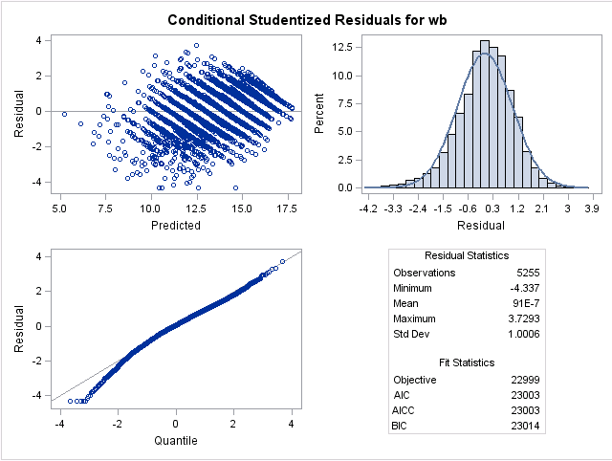

Slide 31
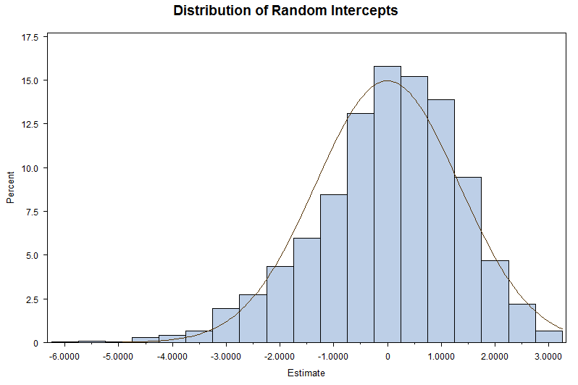

Slide 32
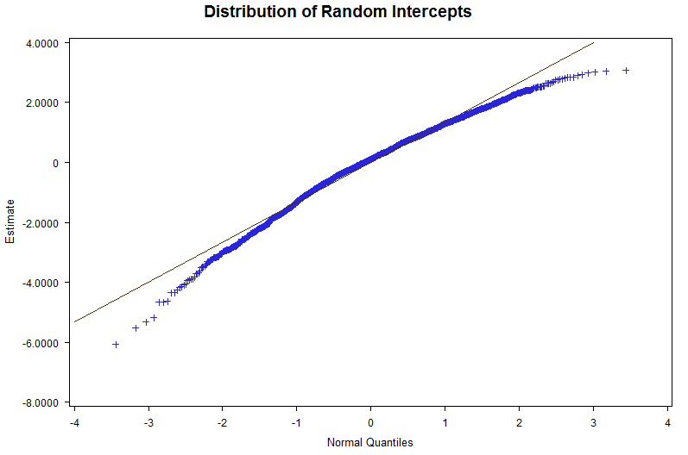

Slide 33
Tests for random slope

Slide 34
Level 1 vs. Level 2?

Slide 35
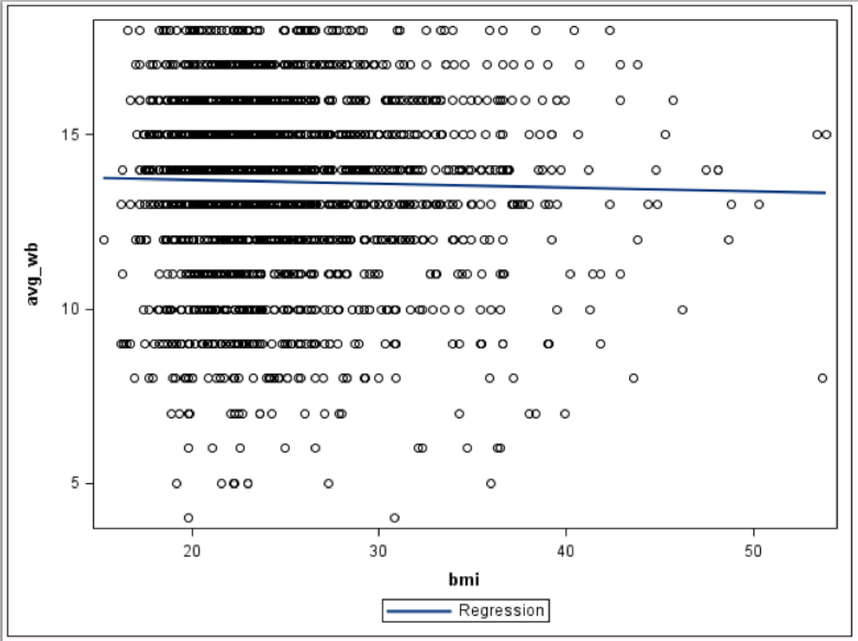
Mean(wb) - BMI

